Slide 1
全球天气数据储存分析与可视化 (Global Weather Data Crawling, Storage, Analysis, and Visualization)

Slide 2
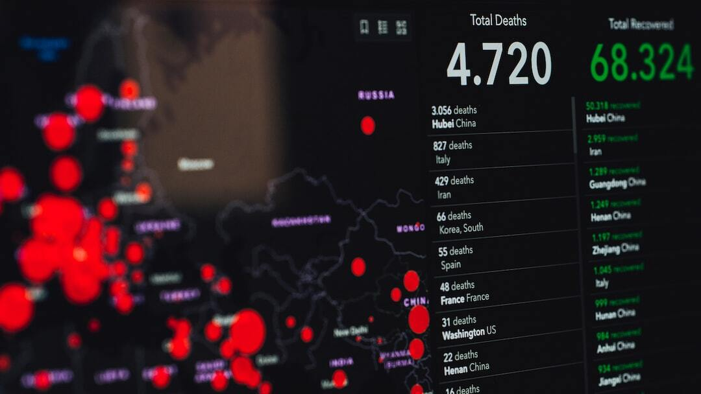
Global Weather Data Crawling, Storage, Analysis, and Visualization
Project Name: Global Weather Data Crawling and Storage Analysis of Visualization
Objective: To create a real-time, continuously updated weather data crawling program using Python.
Applicability: Useful for students and professionals in data science, meteorology, geography, and related fields.
Photo by Markus Spiske on Unsplash

Slide 3
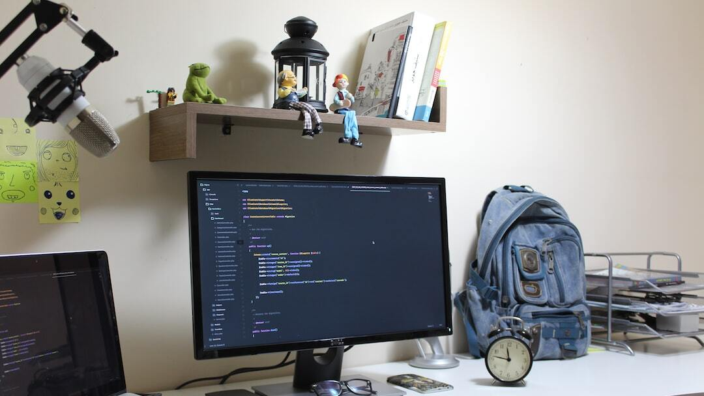
Environment and Tools Setup
System and IDE: macOS Sonoma 14.2, PyCharm Community Arm64
Necessary Libraries: folium, streamlit, plotly, scipy, pandas, numpy, matplotlib, seaborn, scrapy, retry_requests, openmeteo_requests, requests_cache
Photo by Hussam Abd on Unsplash

Slide 4
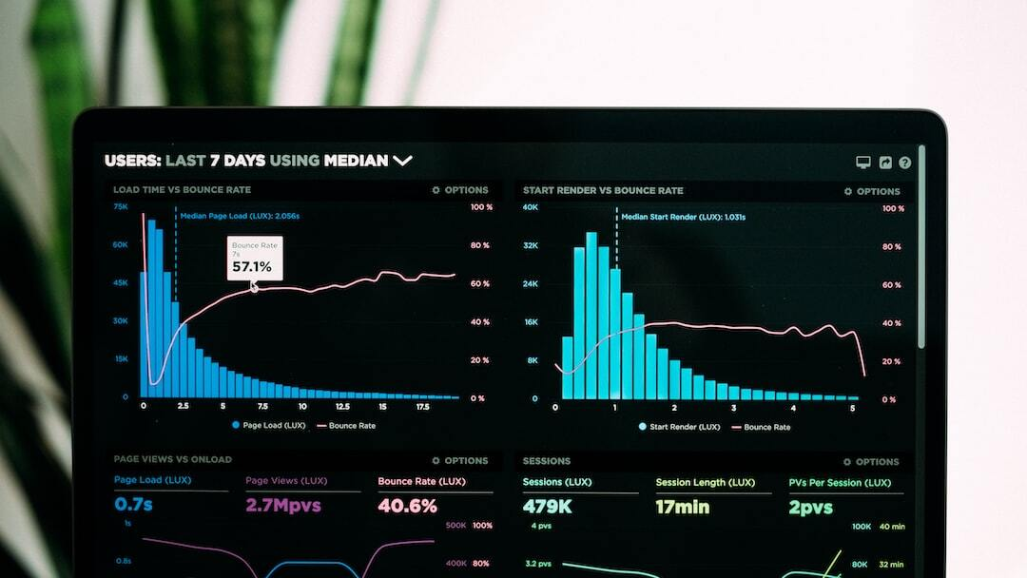
Data Acquisition and Processing Workflow
Data Acquisition: Using spider (Scrapy) or API (Open-Meteo)
Data Storage: JSON Lines format for efficient handling, MySQL for structured storage
Data Analysis: Aggregation and cleaning with Python
Data Visualization: Streamlit for interactive visualization
Photo by Luke Chesser on Unsplash

Slide 5
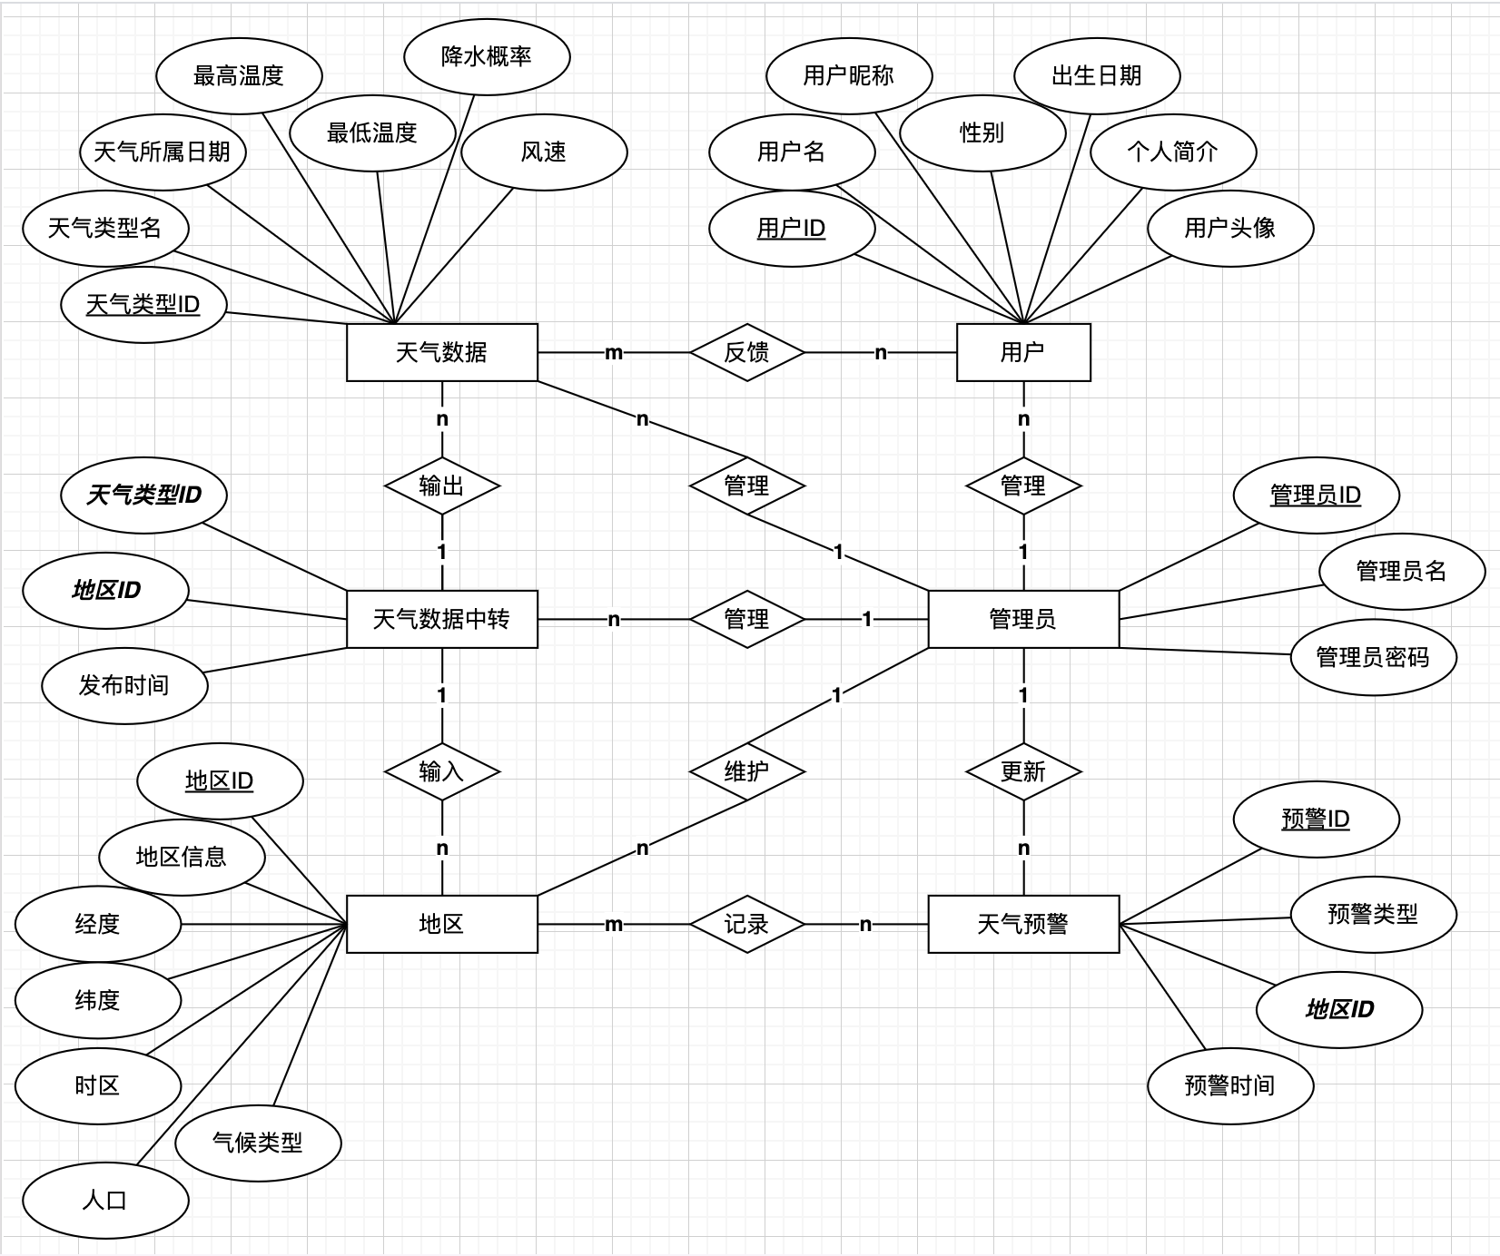

Slide 6
4.5 million datasets
Trace back to the past 10 years, 2014.7-2024.7. the data above are based on the open-meteo, open source weather api, being collected in the range of west, north, south Europe and part of east Europe, North-East and East Asia.

Slide 7


Key Algorithms for Data Analysis
Fourier Transform: Converts time-domain signals to frequency-domain, Reveals periodic components in weather data
$$F\left(ω\right)=\int_{−∞}^{∞}{f\left(t\right)e^{−iωt}} dt$$
Polynomial Regression: Models relationships between temperature and time, Helps predict long-term weather trends
$$y = β_{0} + β_{1} x + β_{2} x^{2} + ⋯ + β_{n} x^{n} +ε$$
Photo by Denis Sebastian Tamas on Unsplash

Slide 8
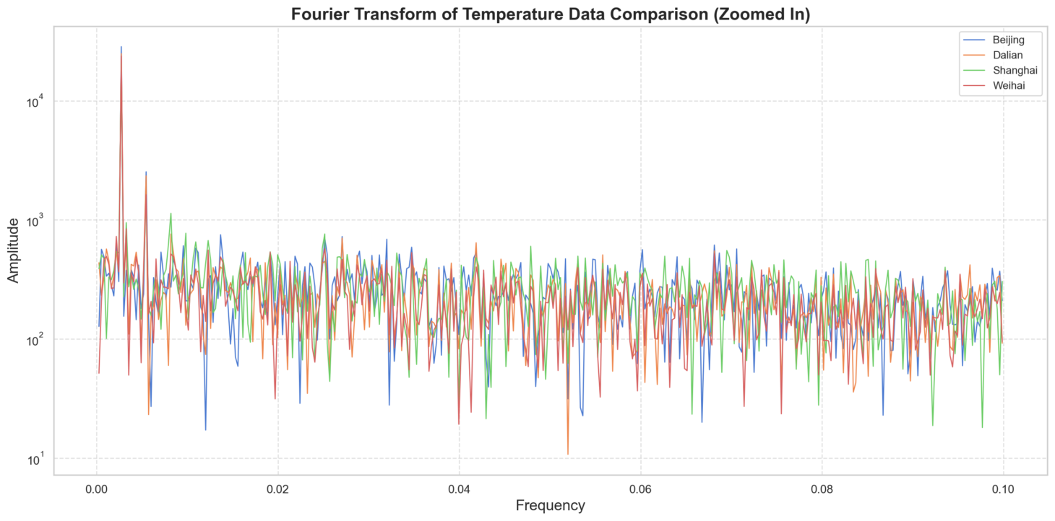

Slide 9
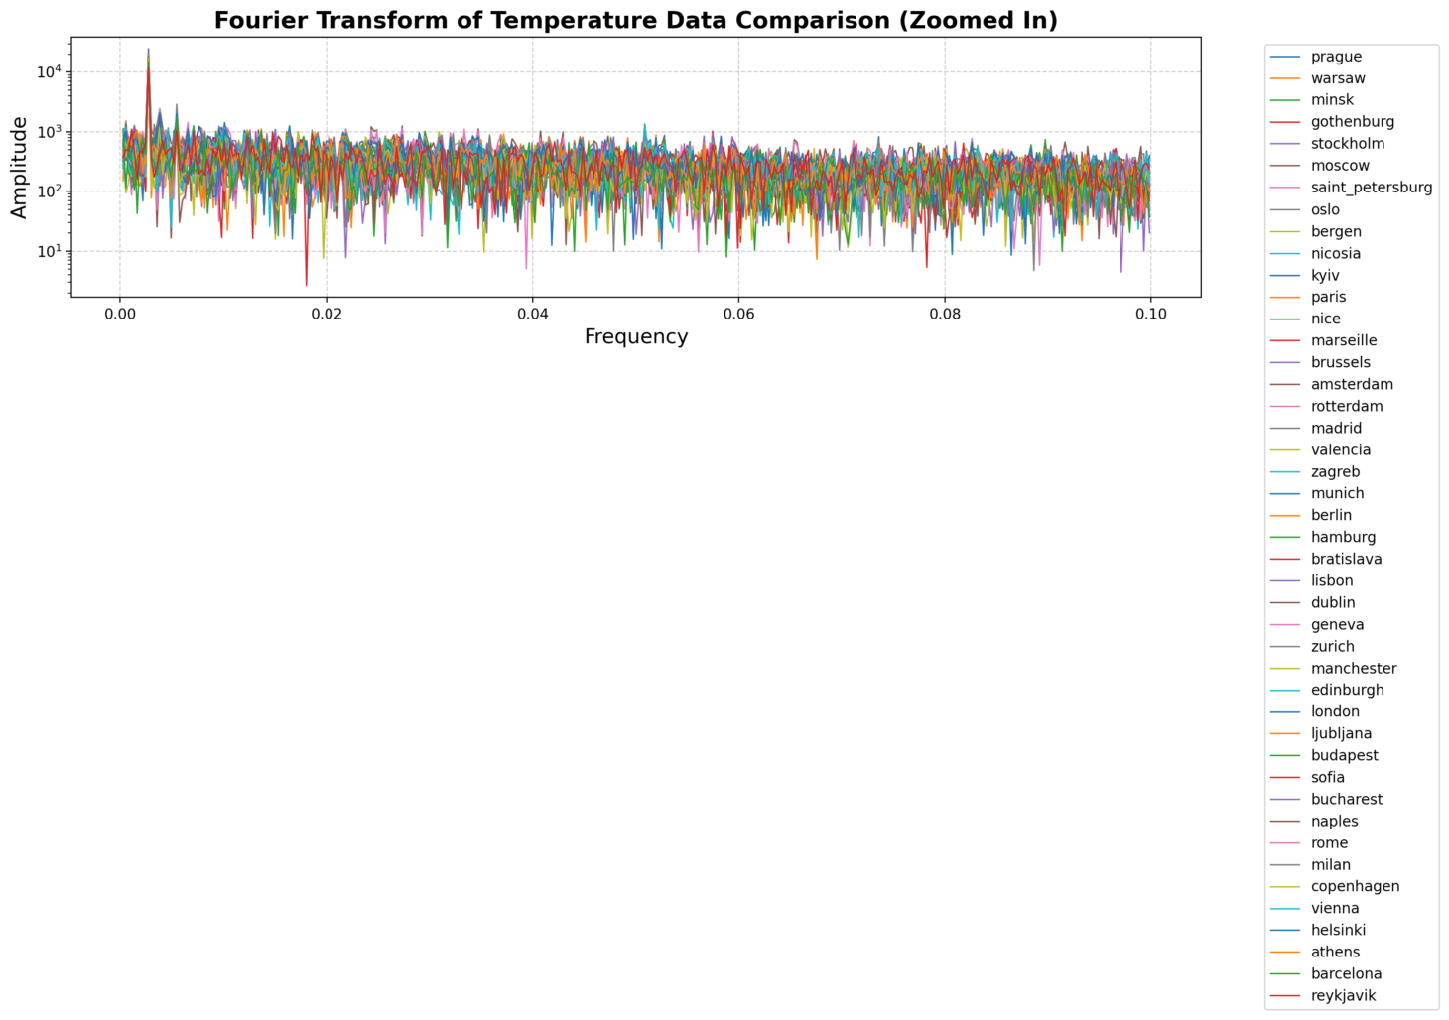

Slide 10
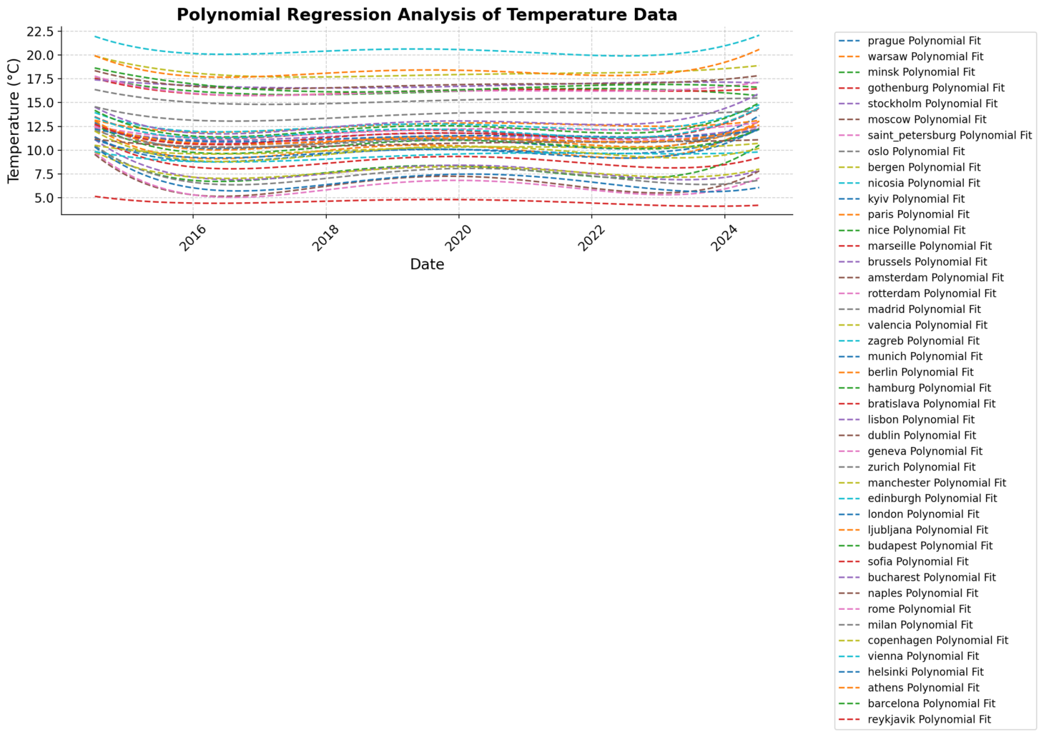

Slide 11
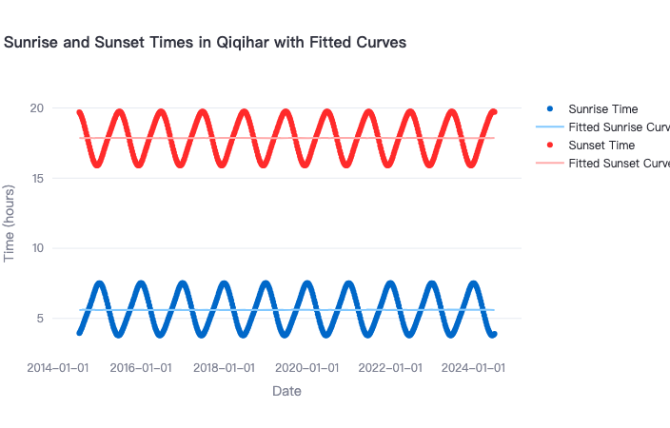
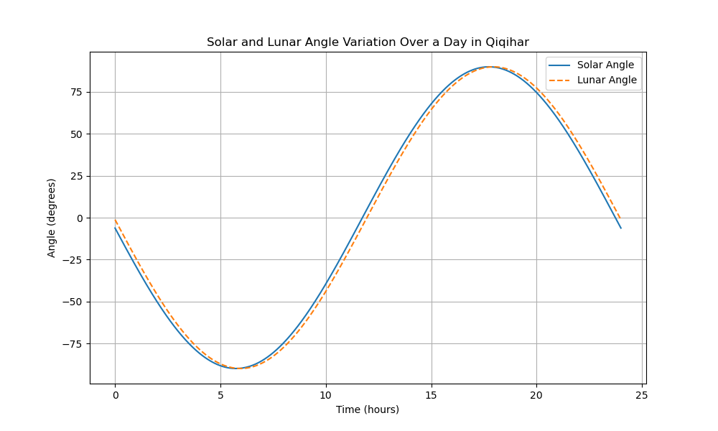
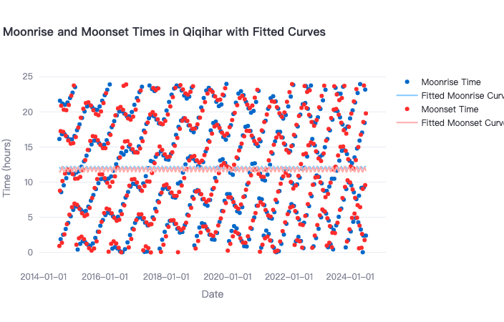

Slide 12
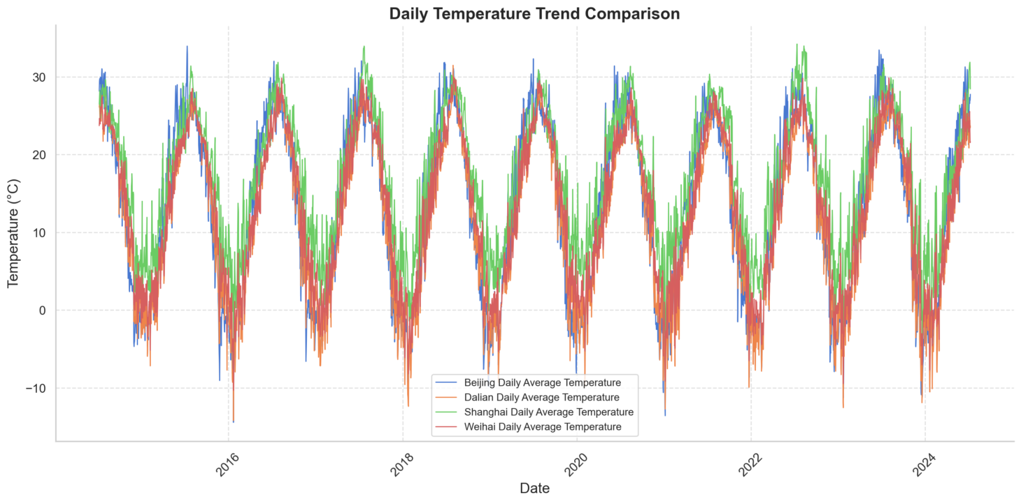
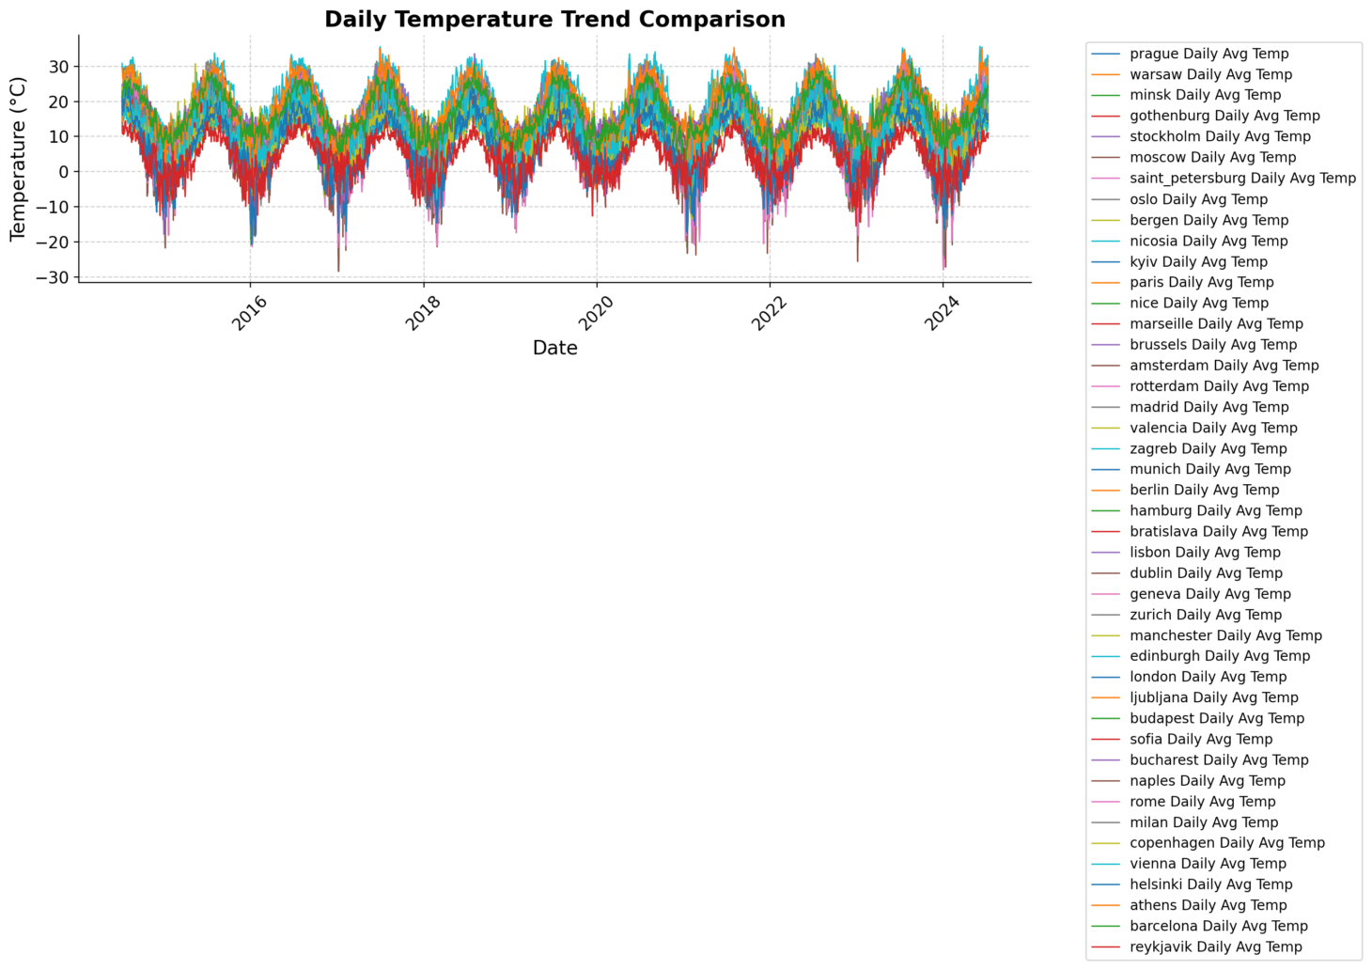
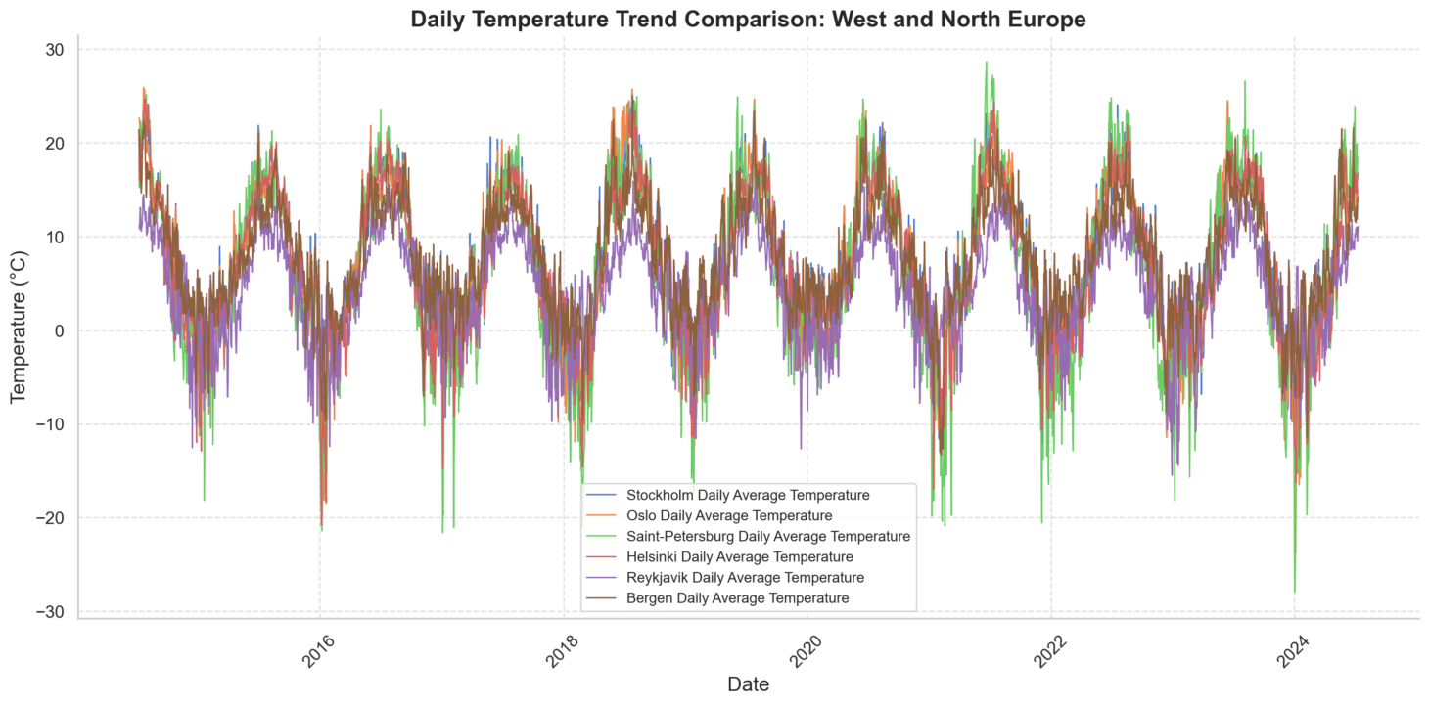

Slide 13
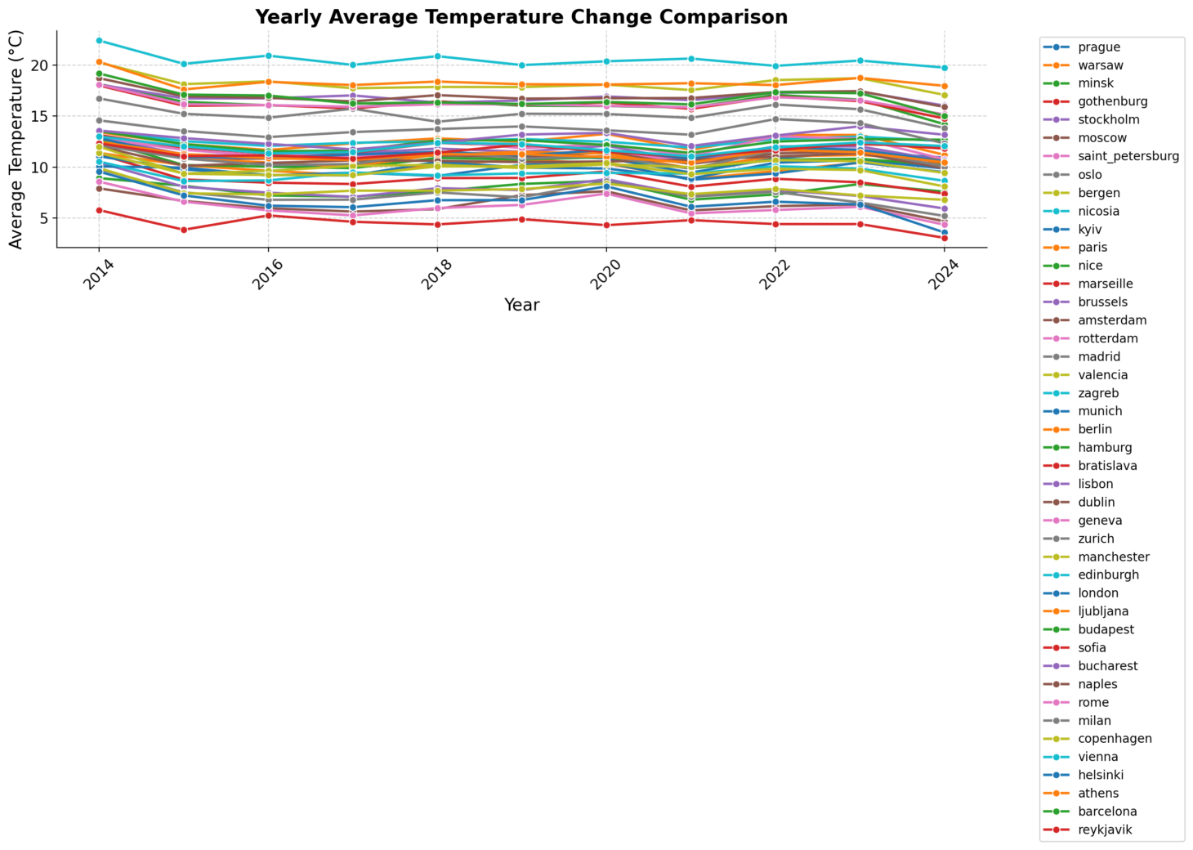
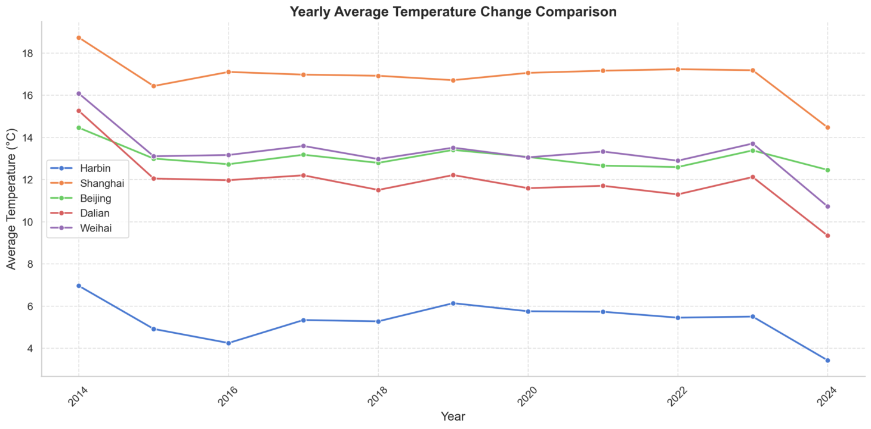
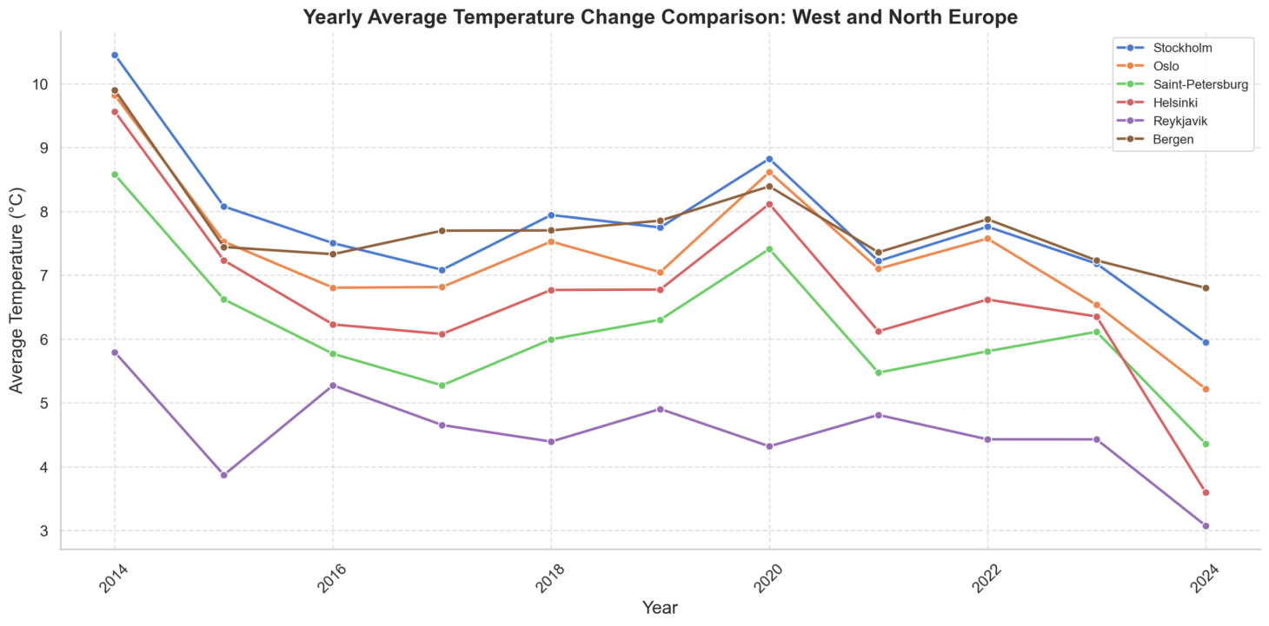

Slide 14
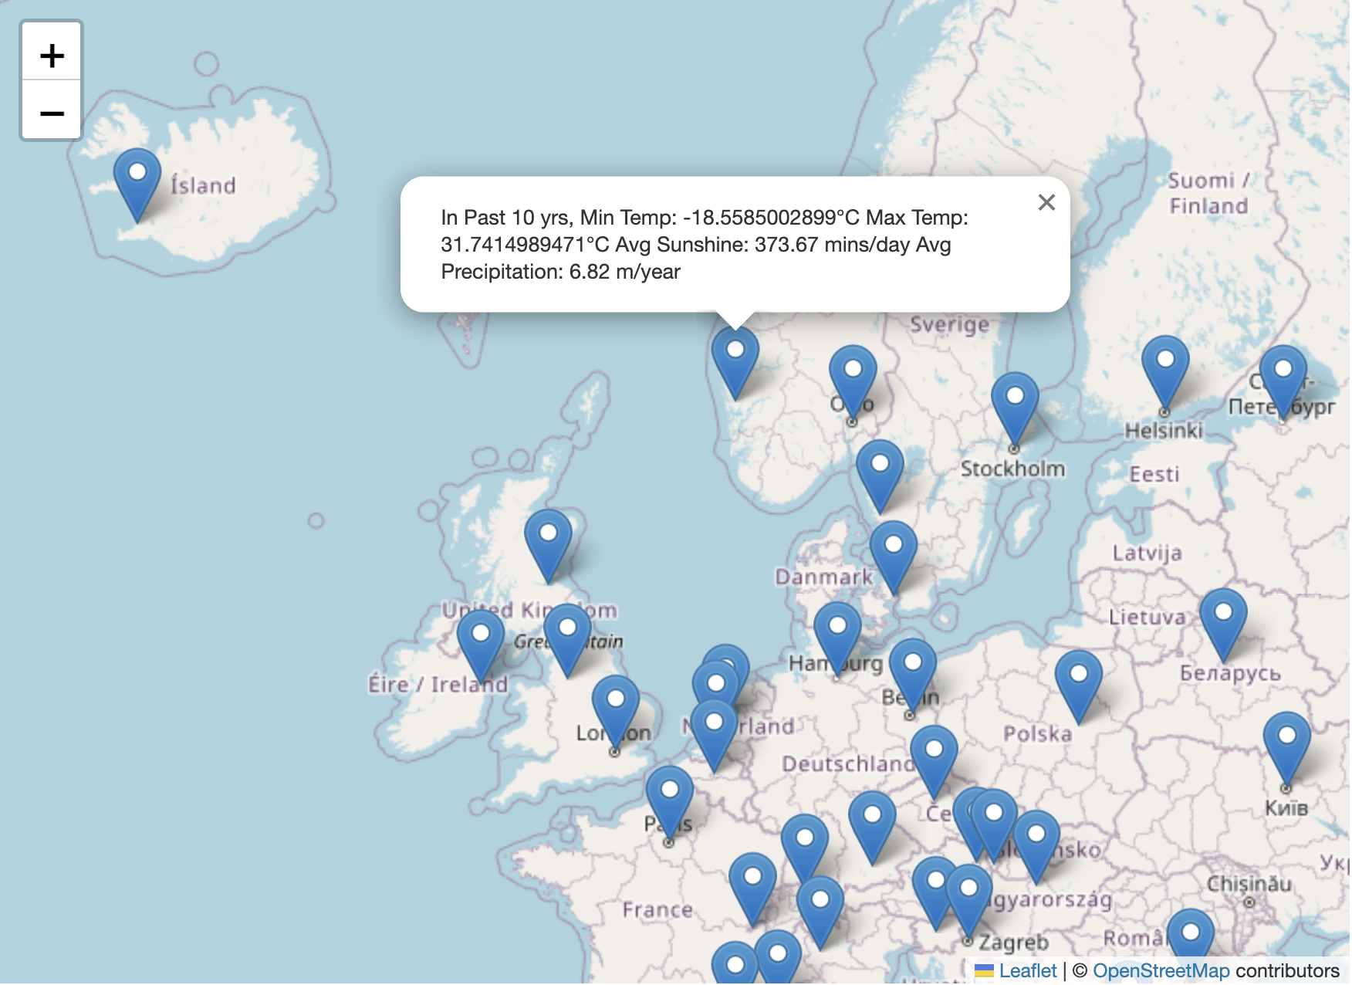

Slide 15
Interactive Data Visualization
Streamlit Overview: Simple, open-source library for creating data applications
Interactive Components: Sliders, buttons, and maps for user interaction
Visualization Libraries: Integration with Matplotlib, Seaborn, Plotly
Photo by Luke Chesser on Unsplash

Slide 16

Enhancements and Future Directions
Data Expansion: Incorporating more global data, including ocean currents and atmospheric pressure
Machine Learning Integration: Using GPUs for large-scale weather prediction
UI and Interaction Enhancements: Improving user interface and adding more interactive features
Open Source Development: Publishing the project on GitHub for community contributions
Photo by Adrien WIESENBACH on Unsplash

Slide 17

Summary and Impact
Summary of Achievements: Successful real-time weather data crawling and visualization, Effective data storage and analysis techniques
Potential Impact: Enhanced weather prediction models, Contribution to data science and meteorology fields
Photo by Markus Spiske on Unsplash

